Slide 1

SportsBook Management System
Made by: BENEDEK bOLYOS, Bence SAsdi, Mate WITTLINGER

Slide 2


General overview
The problem: It is difficult to find motivation and training partners for sports.
The solution: A chat base webpage for people to find training partners.

Slide 3


Functionality
This site helps find training partners through chat.
Build-in functions:
Registration and login (email confirmation)
Create chat rooms
Chat
Email sending (support)
Project support (premium purchase)
Modify profile

Slide 4

Program
Backend
Notepad++
PhpMyAdmin
Frontend
HTML, CSS
JavasScript
Bootstrap
Database
MySQL

Slide 5

Backend
Languages:
JavaScript
PHP
SQL

Slide 6

Frontend
Languages:
HTML
CSS
JavaScript
Frameworks:
Bootstrap

Slide 7
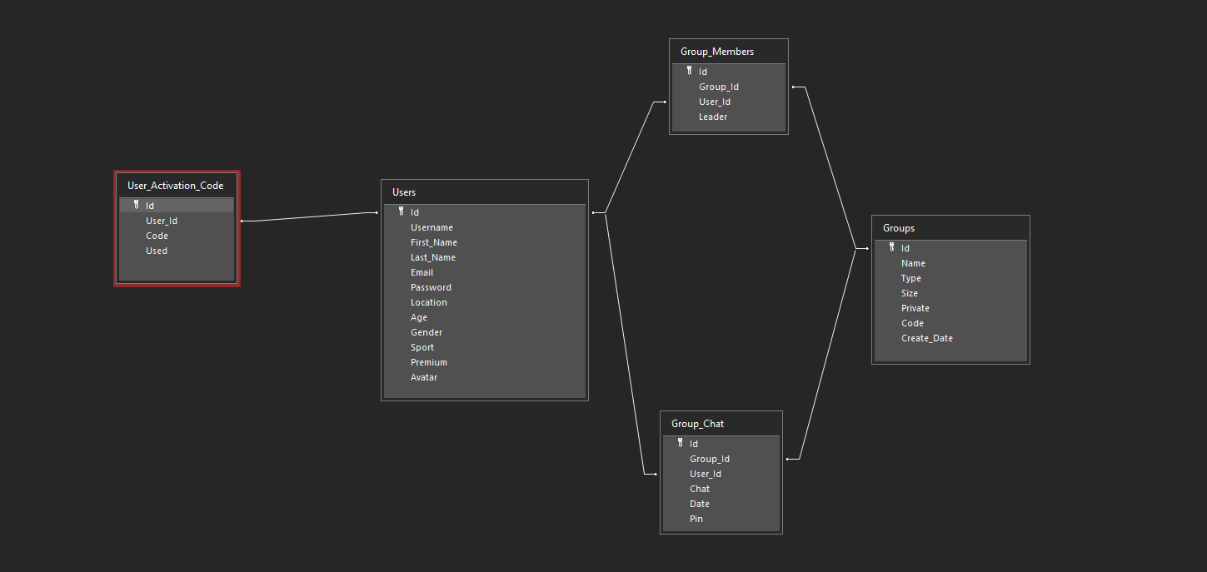
DatabasE

Slide 8
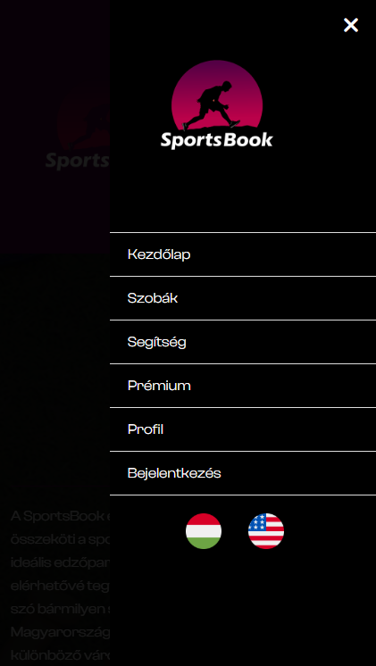
RESPONSIVITY
Optimized for mobile devices
Access from anywhere

Slide 9

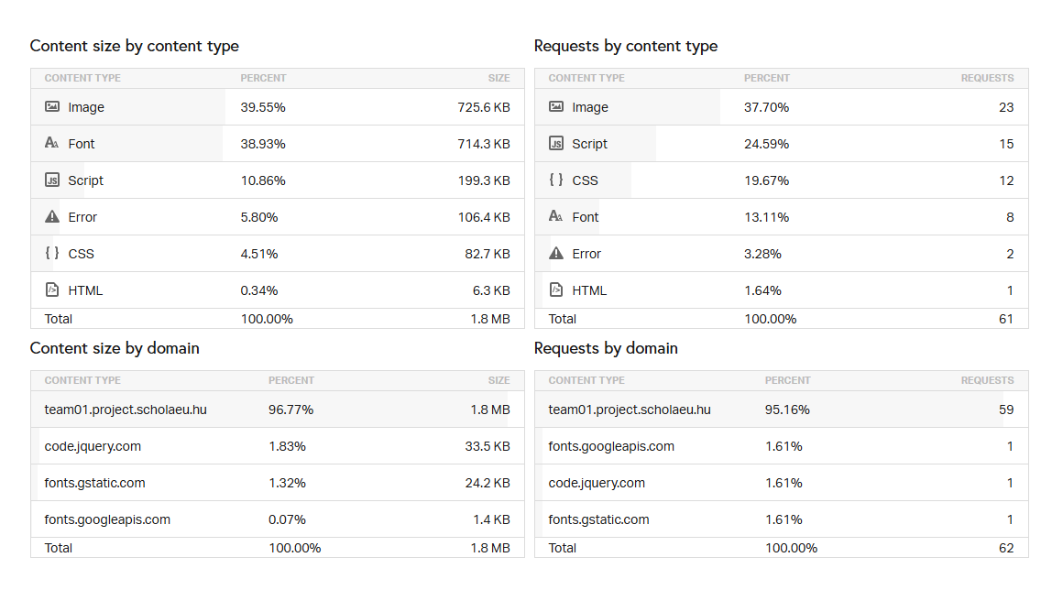
Testing
Functional Testing
Responsive Testing
Cross-Browser Testing
Performance Testing

Slide 10


Publication
School web server

Slide 11


TEAMWORK
Discord
Google Sheets

Slide 12

Teamwork
Approach (hogyan osztottátok fel. Pl. programnyelv/funkciók/tudás szerint)
Benedek Bolyos: (tagonként részletezzük a szerepeket)
Team leader
Documentation
Database
Profile/editing Profile frontend/backend
Background/frontend support
Bence Sasdi:
Registration/login frontend/backend
Database
Powerpoint/exam text
Email sending background
Premium frontend
Mate Wittlinger:
Chat/chat room Backend
Database
Photoshop work
Background/frontend support
Profile background

Slide 13

IN THE future
What’s next:
New functions (kick/ban, dark mode)
Premium
Online payment
Mobile application

Slide 14

Thank you for your attention!

